Slide 1
AGE GROUP CLASSIFIER
R.JOHN BUNNY
25A31A0148

Slide 2

The Feature-Based Age Group Classifier is a simple C project that predicts a person’s age group by analysing observable physical features like hair, teeth, skin and height.
Each feature is given a score, and the total score determines the age group such as:
Child
Teenager
Adult
Senior Citizen
This project demonstrates decision-making, modular programming, and calculation-based classification.

Slide 3
REQUIREMENTS
Hardware Requirements : Any PC or Laptop with a minimum of 512 MB
RAM20 MB free storage
Software Requirements : C Compiler (Turbo C / Code::Blocks / GCC)Operating System: Windows/Linux
Knowledge Required : Basics of C programming using functions, conditional statements (if-else) taking input and printing out

Slide 4
ALGORITHM
Step 1: Initialize and Display Title
All required variables such as hair, teeth, skin, height, and total score are initialized.
The program also displays the title name:
“AGE GROUP CLASSIFIER (Feature Based)”
Step 2: Read Hair Feature (1–3)
The program accepts the hair feature value from the user.
1 → Child-like hair
2 → Teenage hair
3 → Adult/Senior hair
This input represents hair development based on age.

Slide 5

Step 3: Read Teeth Feature (1–3)
The teeth feature is taken as input.
1 → Milk teeth (child)
2 → Developing teeth (teenager)
3 → Fully developed teeth (adult/senior)
Teeth growth is a strong biological indicator of age.
Step 4: Read Skin Feature (1–3)
The skin condition is read from the user.
1 → Very smooth skin
2 → Normal skin
3 → Aging or wrinkled skin
This feature helps distinguish young and older age groups.

Slide 6
Step 5: Read Height Feature (1–3)
The height value is taken as input.
1 → Short height
2 → Medium height
3 → Full height
Height changes significantly across age groups.
Step 6: Calculate Total Score
All the feature values are added:
Total = hair + teeth + skin + height
This total score represents the overall physical development.
Step 7: If Total ≤ 6 → Child
If the total score is 6 or less, the features indicate early development.
Hence, the age group is classified as Child.

Slide 7
Step 8: Else If Total is Between 7 and 9 → Teenager
If the total score falls between 7 and 9, partial maturity is observed.
The person is classified as a Teenager.
Step 9: Else If Total is Between 10 and 11 → Adult
If the total score is 10 or 11, full physical maturity is present.
The person is classified as an Adult.
Step 10: Else → Senior
If the total score is greater than 11, advanced age characteristics are observed.
The person is classified as a Senior Citizen.

Slide 8
Step 11: Display Age Group
The identified age group is displayed as output to the user.
Step 12: Stop
The program execution is terminated.

Slide 9
FLOWCHART
Start
Read hair feature
Read teeth feature
Read height feature
Hair+Teeth+Skin+Height
Total<=6
No
Yes
Total 7-9?
Child
No
Teenager
Adult
Stop

Slide 10
MODULE DESCRIPTION
Module–1: Read Features
Module–2: Calculate Scores
Module–3: Classify Age Group
Module–4: Display Output

Slide 11
Logic (Module-wise Logic)
Module 1 – Feature Input Logic
Ask user to enter values from 1 to 3 for each feature
  1 → Weak/Poor
  2 → Normal
  3 → Strong/Healthy
Module 2 – Score Calculation Logic
Total_Score = hair + teeth + skin + height;
Module 3 – Age Group Classification Logic
if(total <= 6) → Child
else if(total <= 9) → Teenager
else if(total <= 11) → Adult
else → Senior
Module 4 – Output Logic
Print age group on screen.

Slide 12
Module-wise Program
Module 1: Input
int getFeatures() {
int h, t, s, ht;
printf("Enter Hair score (1-3): ");
scanf("%d", &h);
printf("Enter Teeth score (1-3): ");
scanf("%d", &t);
printf("Enter Skin score (1-3): ");
scanf("%d", &s);
printf("Enter Height score (1-3): ");
scanf("%d", &ht);
return h + t + s + ht;
}

Slide 13
Module 2: Calculation
int calculateTotal(int score) {
return score;
}
Module 3: Classification
void classifyAgeGroup(int total) {
if(total <= 6)
printf("\nAge Group: CHILD\n");
else if(total <= 9)
printf("\nAge Group: TEENAGER\n");
else if(total <= 11)
printf("\nAge Group: ADULT\n");
else
printf("\nAge Group: SENIOR CITIZEN\n");
}

Slide 14
Modules Integration
#include <stdio.h>
int getFeatures();
int calculateTotal(int score);
void classifyAgeGroup(int total);
int main() {
int featureScore, total;
printf("\n--- AGE GROUP CLASSIFIER (Feature Based) ---\n");
featureScore = getFeatures();
total = calculateTotal(featureScore);
printf("\nTotal Feature Score = %d", total);
classifyAgeGroup(total);
return 0;
}
int getFeatures() {
int h, t, s, ht;
printf("\nEnter Hair score (1-3): ");
scanf("%d", &h);

Slide 15
printf("Enter Teeth score (1-3): ");
scanf("%d", &t);
printf("Enter Skin score (1-3): ");
scanf("%d", &s);
printf("Enter Height score (1-3): ");
scanf("%d", &ht);
return h + t + s + ht;
}
int calculateTotal(int score) {
return score;
}

Slide 16
void classifyAgeGroup(int total) {
if(total <= 6)
printf("\nAge Group: CHILD\n");
else if(total <= 9)
printf("\nAge Group: TEENAGER\n");
else if(total <= 11)
printf("\nAge Group: ADULT\n");
else
printf("\nAge Group: SENIOR CITIZEN\n");
}

Slide 17
Execution & output
--- AGE GROUP CLASSIFIER (Feature Based) ---
Enter Hair score (1-3): 2
Enter Teeth score (1-3): 3
Enter Skin score (1-3): 2
Enter Height score (1-3): 3
Total Feature Score = 10
Age Group: ADULT

Slide 18
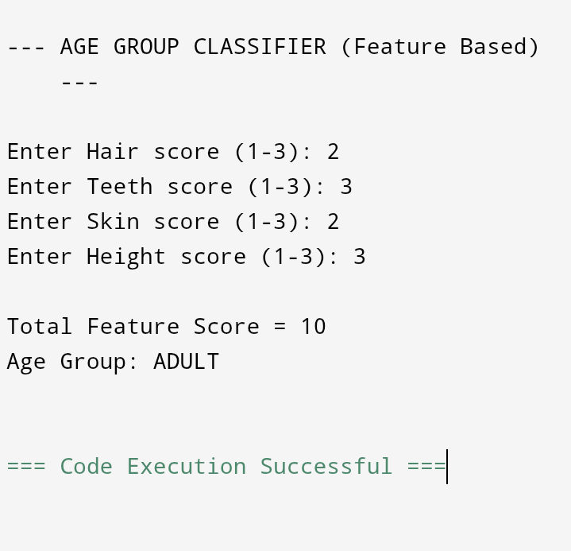
Result :

Slide 19
CONCLUSION
The Feature-Based Age Group Classifier accurately identifies age groups by analysing simple physical features and calculating a total score. This project effectively applies conditional statements and modular programming, making the classification process clear, simple, and efficient.

Slide 20
Thank you

